Slide 1

ST10260039-PROG6212-POE
Monthly Claim System Website

Slide 2
Submission Requirements
Step by step instructions to connect Database (SSMS)
Once Visual studio project has been opened, The are a few changes needed to be made for Database to be fully operational with your project, first step is connecting to a server , actually creating your database , then you need to store your server name somewhere, needed later, a connection is needed to be made that will connect the database to your project which can be done on your appsettings.json on your Visual Studio Project, which your server name and Database name needs to be included in your connection string , secondly a ApplicationDbContext file needs to be created . A command line that can be inserted on you Package Manager Console which is ' Updata Databse ' will ensure that your database has all the required tables for what the database is intended for.

Slide 3
Login Information
Hr user – hr@cms.com
Manager resposnible for approving.rejecting claims – Manager@cms.com
Coordinator which is responsible for verifying/ rejecting claims before it reaches the Manager – Coordinator@cms.com
Lecturer which submits claims – Lecturer@cms.com
ALL PASSWORDS ARE THE SAME AS THE USERNAMES
EXAMPLE – email for hr will be hr@cms.com and password will be hr@cms.com, etc

Slide 4
Updates made from Part 2
Role-Based Login System for Secure User Access
Our platform now features a robust role-based login system tailored for Lecturers, Coordinators, Managers, and HR personnel, ensuring every user accesses only what they are authorized to see.
Enhanced Security Features
Session-based authentication protects restricted pages and prevents unauthorized users from accessing content—even through direct URL entry. Each role experiences a clearly defined and secure environment.
A security filter ensures that only users with a valid session and the correct role can proceed, reinforcing controlled access throughout the system.
Password hashing, powered by ASP.NET Identity, adds an additional layer of protection by safeguarding user credentials against unauthorized retrieval.

Slide 5
New HR-Exclusive Functionality
Users assigned to the HR role now benefit from powerful administrative tools designed to streamline oversight and control.
Claims Reporting Dashboard
HR can:
View a complete list of all claims across the platform
Apply advanced filters, including:
Status
Lecturer name
Minimum/maximum amount or rate
Date range
Access supporting documents for each claim
Export a comprehensive CSV summary for offline review and reporting
Manage Lecturer Hourly Rates
HR users can update the system-wide lecturer hourly rate. Once adjusted, any newly submitted claims automatically apply the updated value—ensuring accuracy and consistency without manual intervention.

Slide 6
Manage user accounts feature – HR users can now add new Lecturers, edit their hourly rate, and filter and search claims submitted by a specific lecturer. HR users can also download reports in CSV or Excel format based on the filtered search results.
Both Coordinator and Manager users can approve or reject claims as required, and they are now able to view the full history of claims they have approved or rejected. The system makes use of an SSMS LocalDB implementation for database management, and unit tests have been added for all controllers to ensure reliability and consistent functionality. Lecturer users can now view a complete history of all claims they have submitted, allowing them to track every submission from initial entry through to final status.
Screenshots of unit tests made will be on the next slide

Slide 7
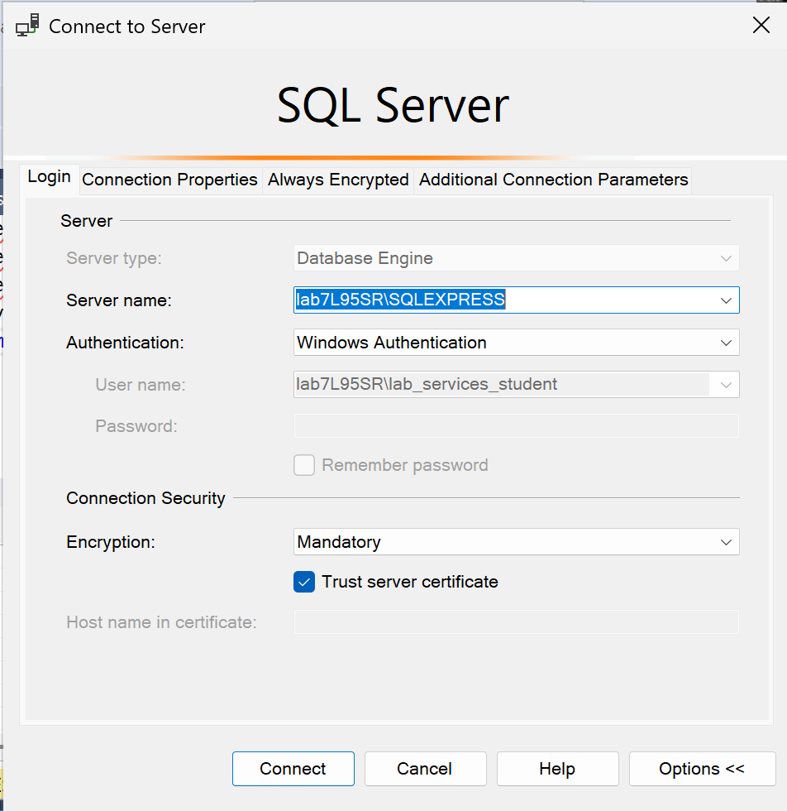
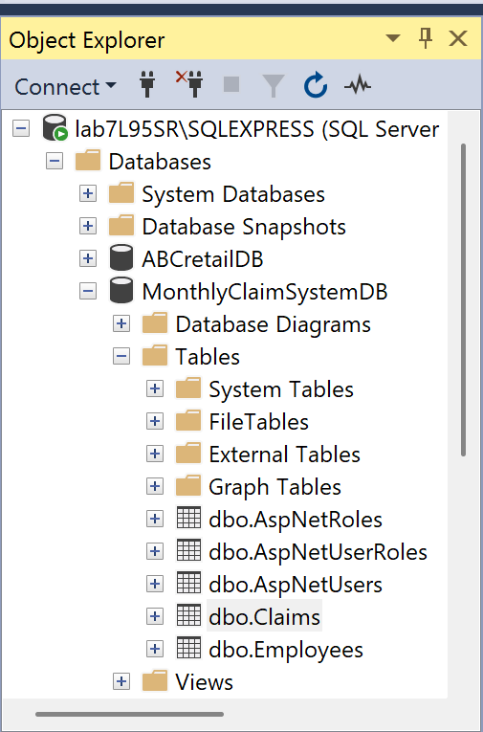
SSMS Database
Attached are sreenshots of the tables created and server name

Slide 8
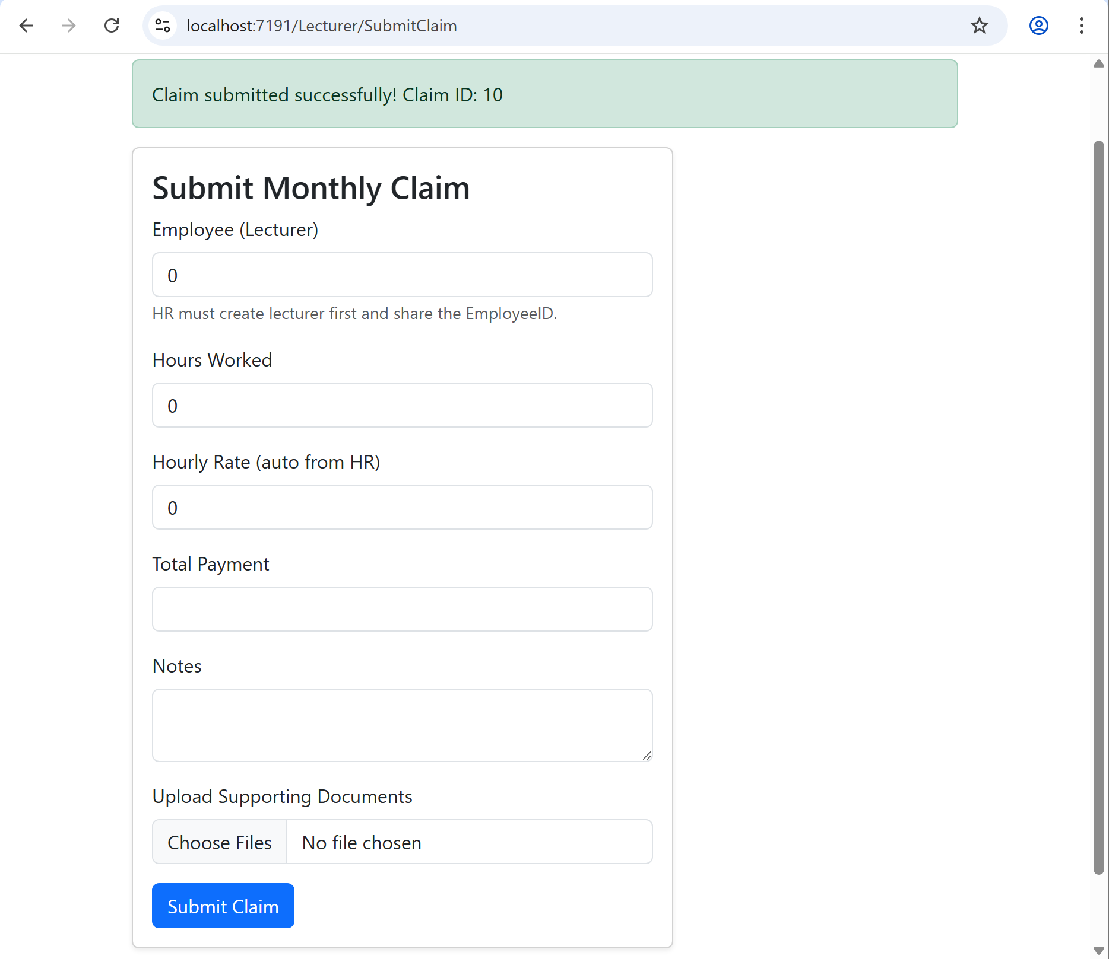

Slide 9
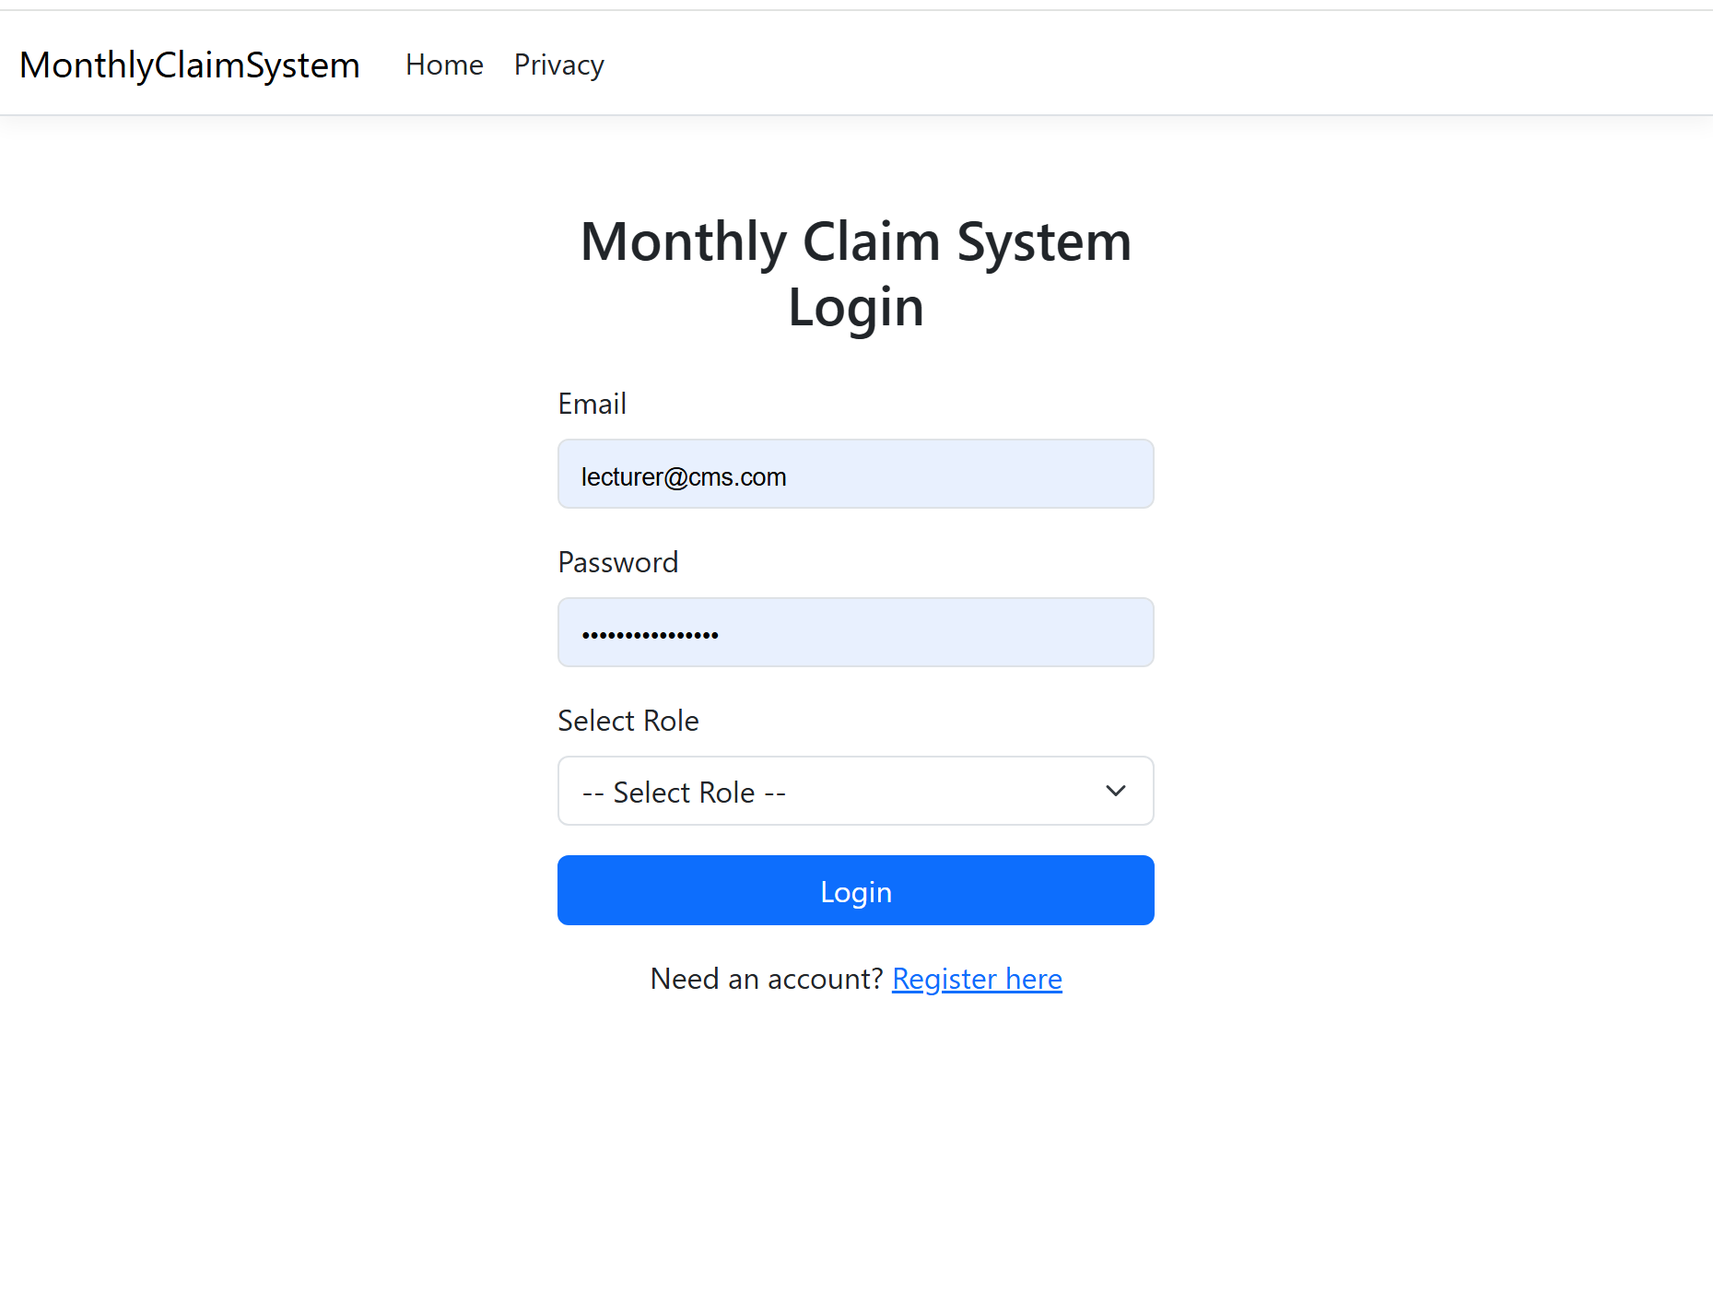

Slide 10
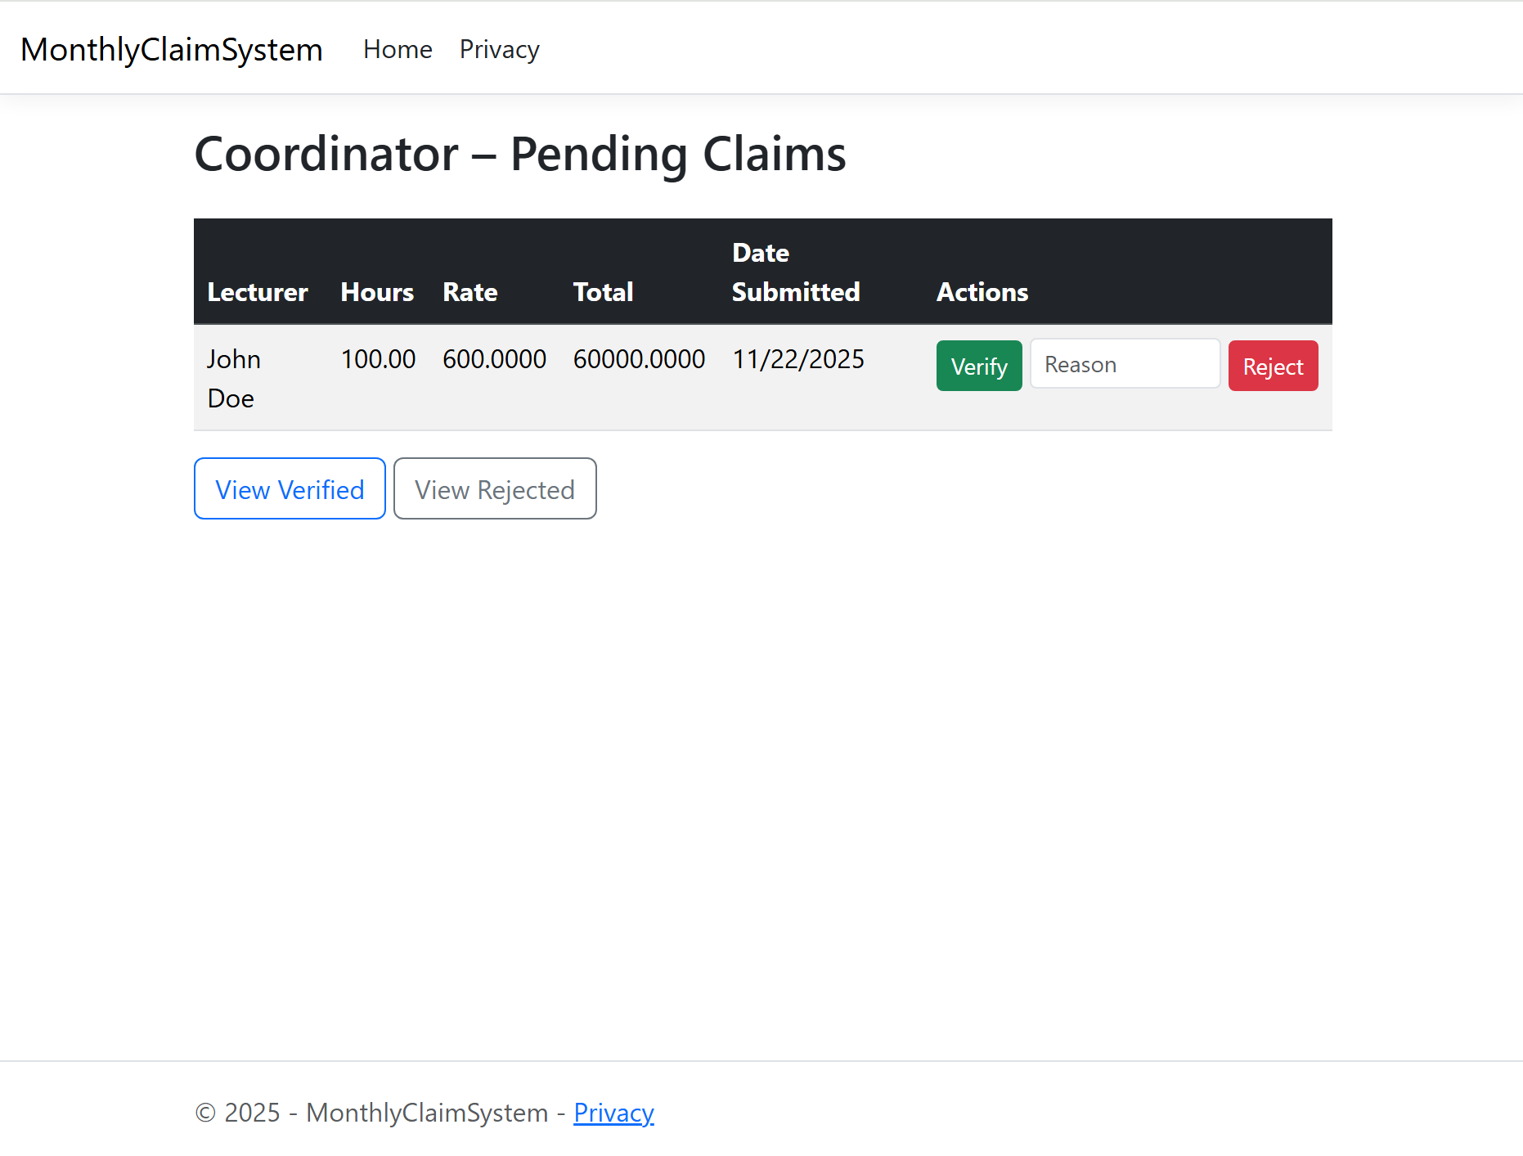

Slide 11
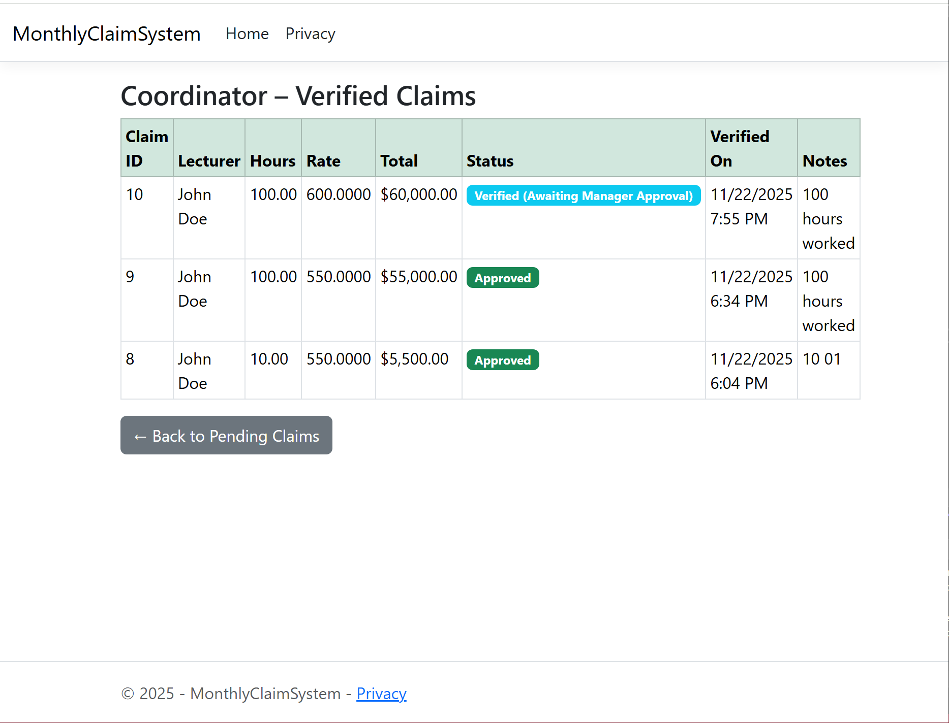

Slide 12
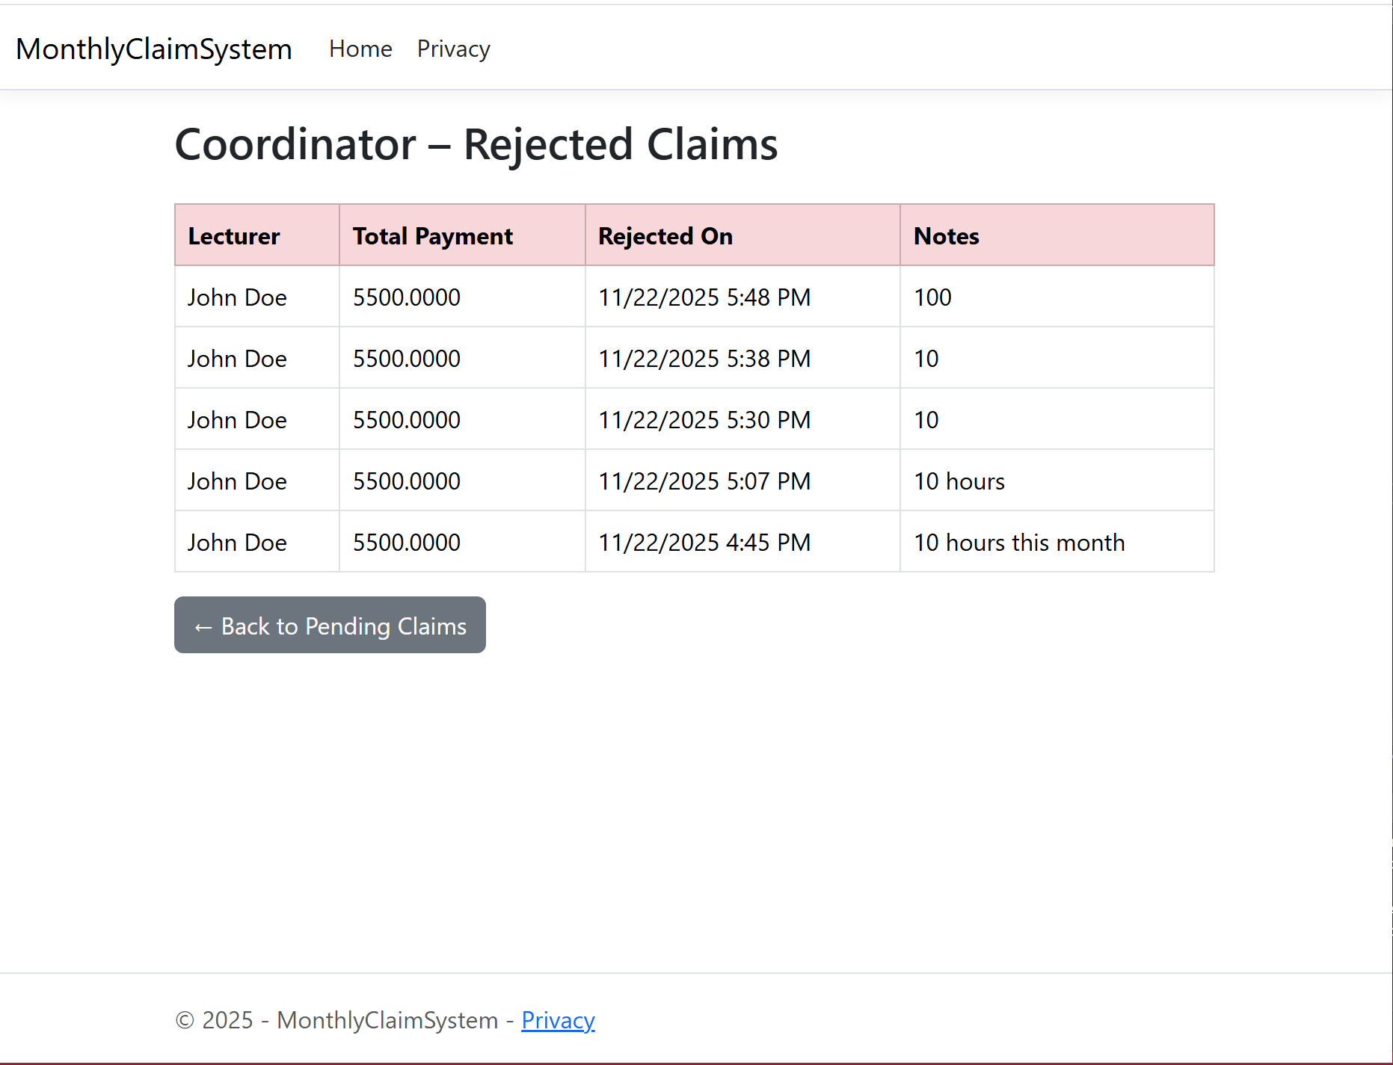

Slide 13
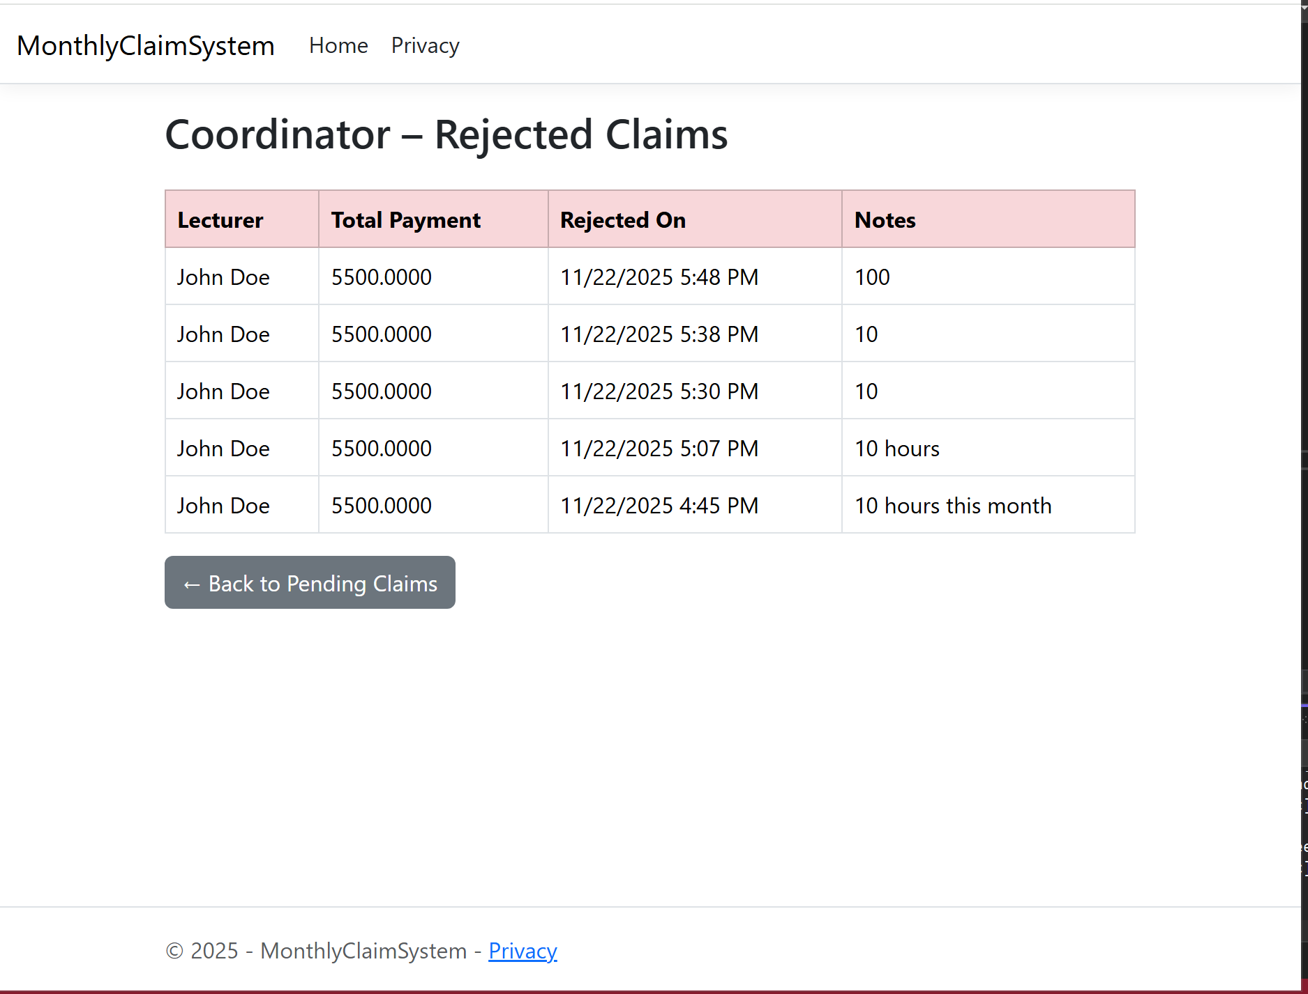

Slide 14
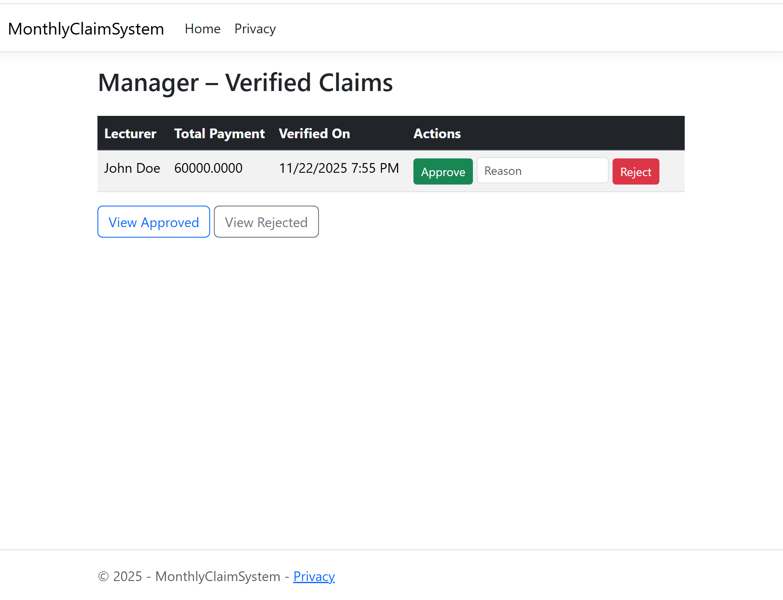

Slide 15
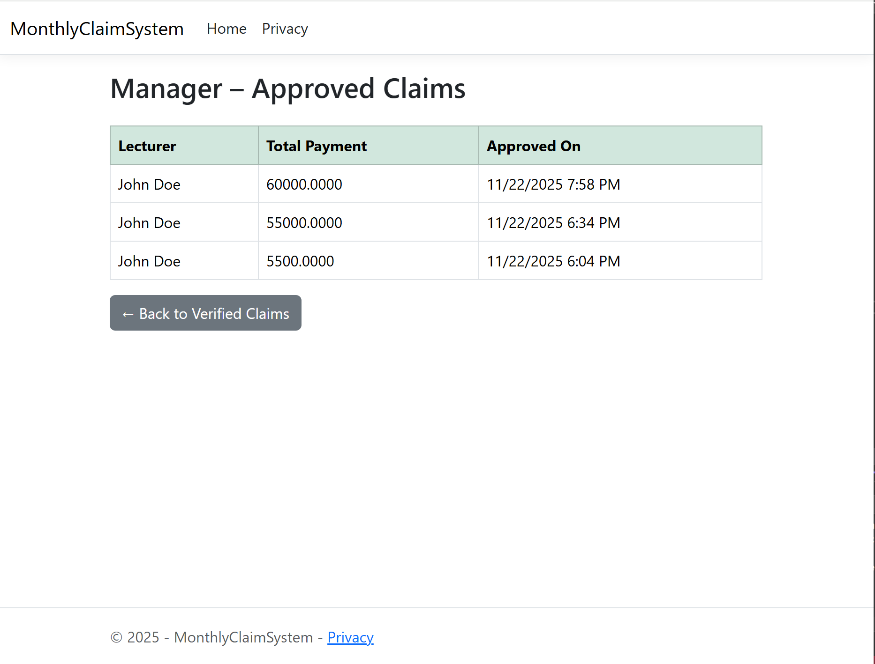

Slide 16
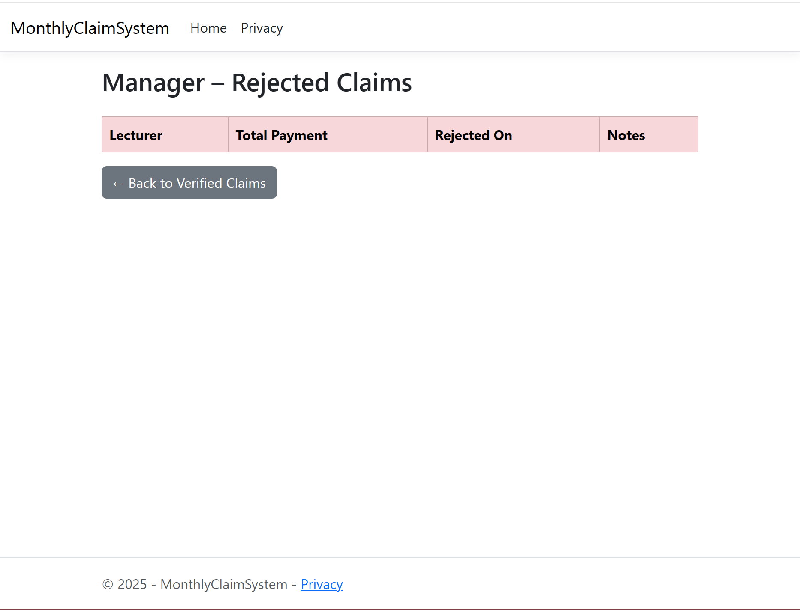

Slide 17
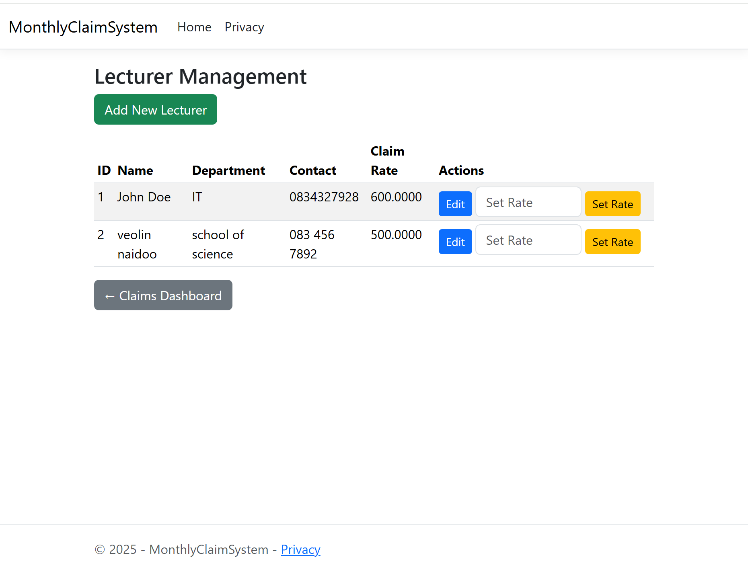

Slide 18
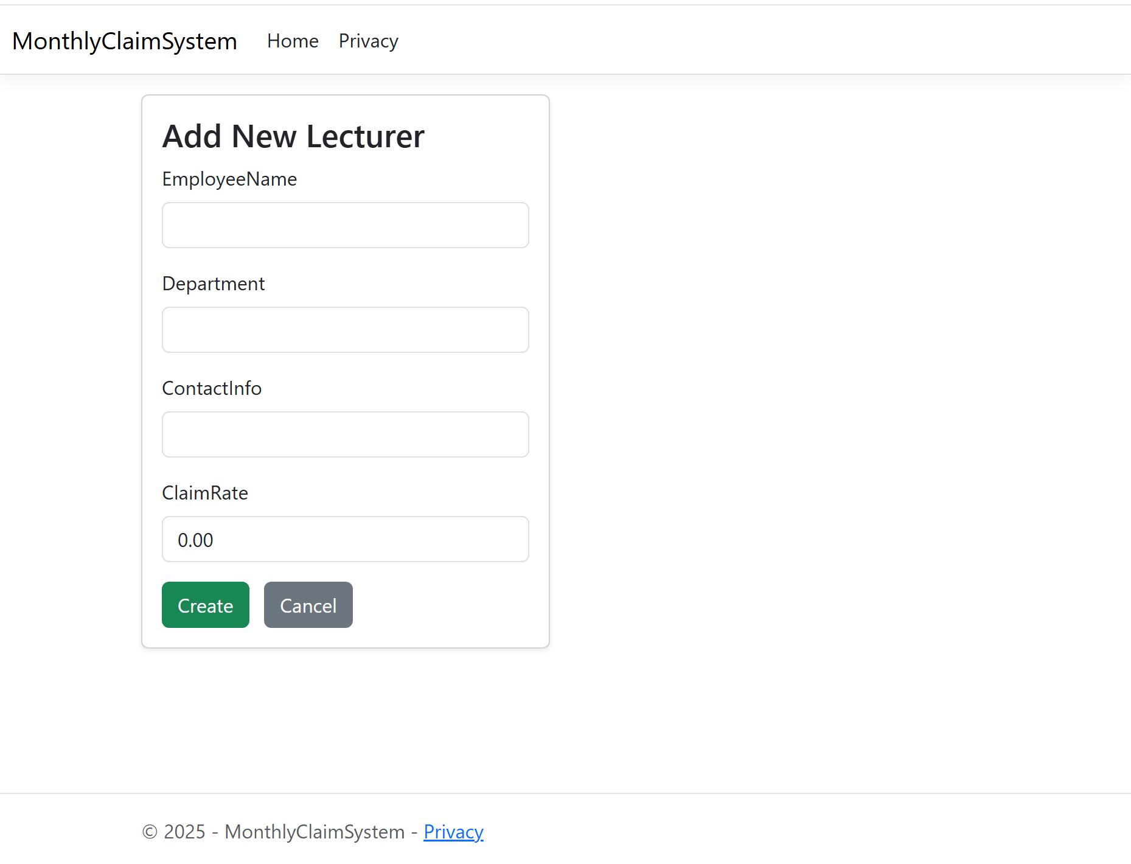

Slide 19
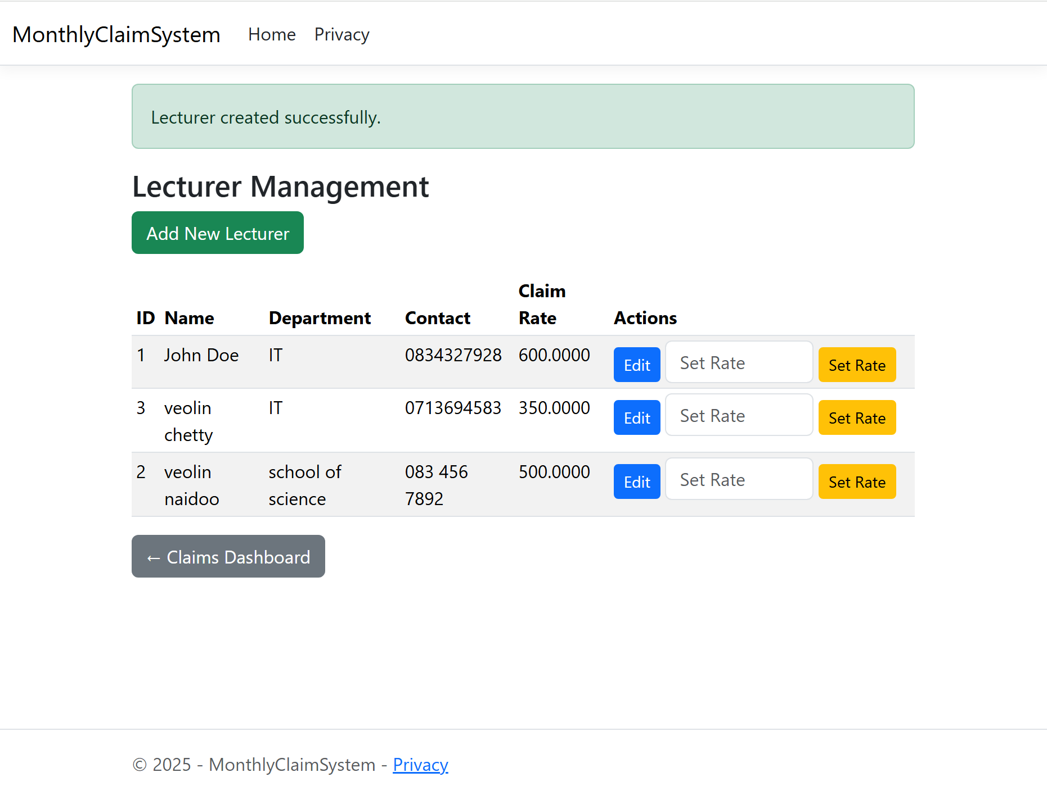

Slide 20
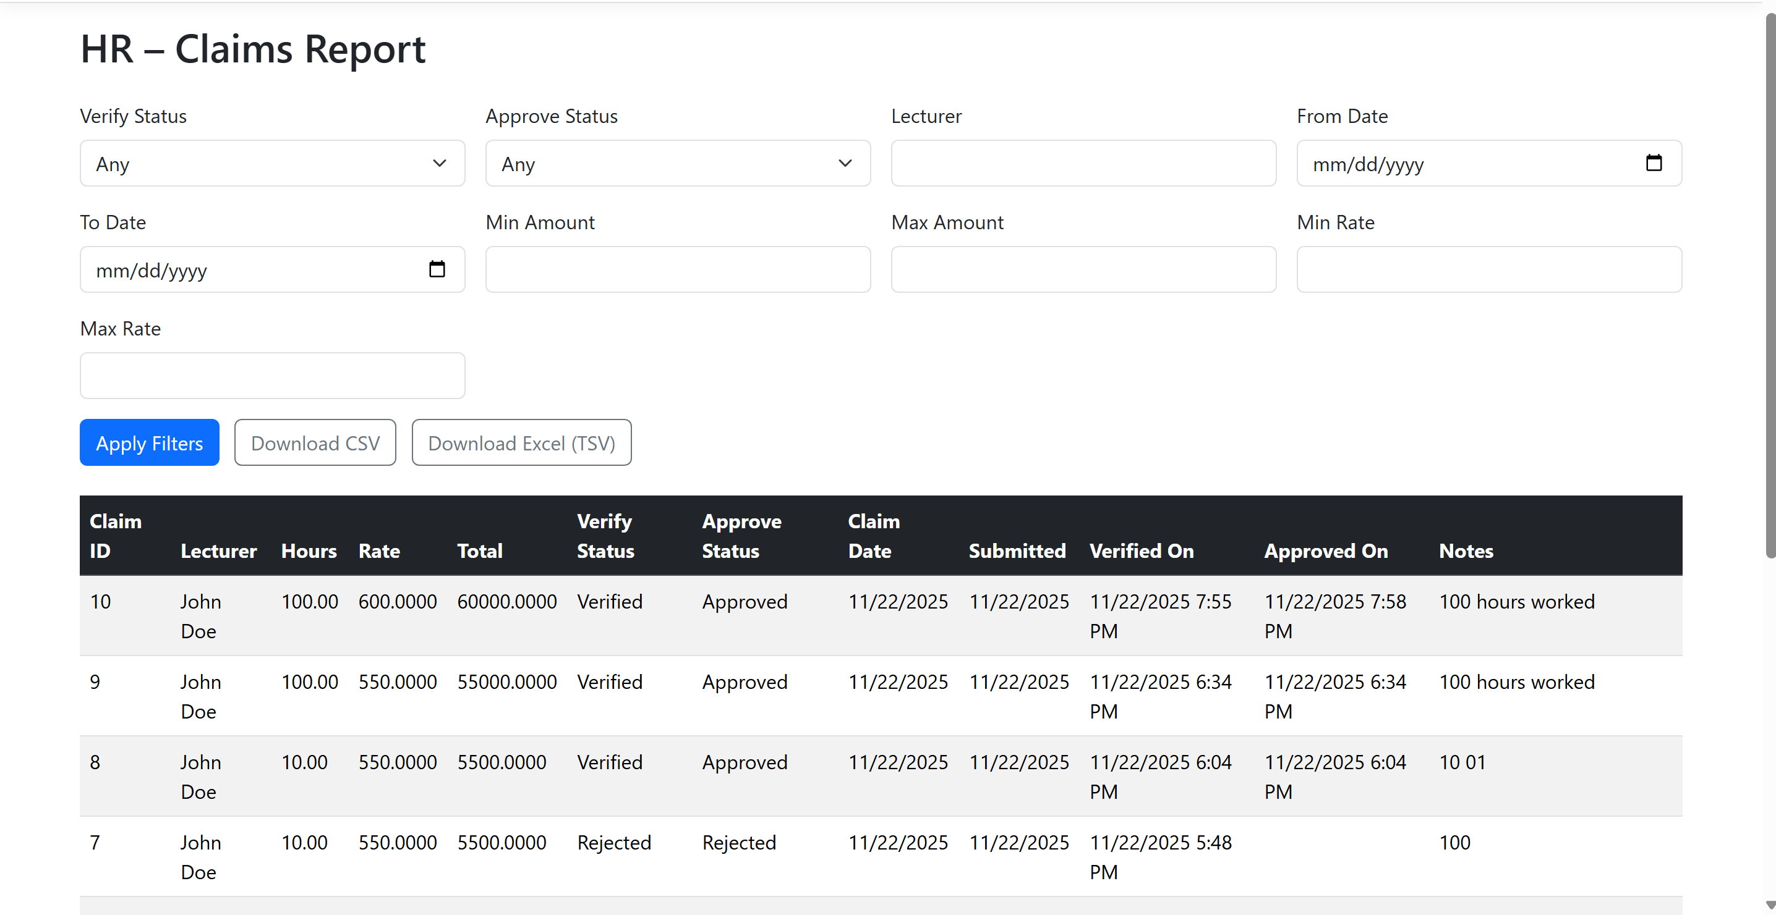

Slide 21
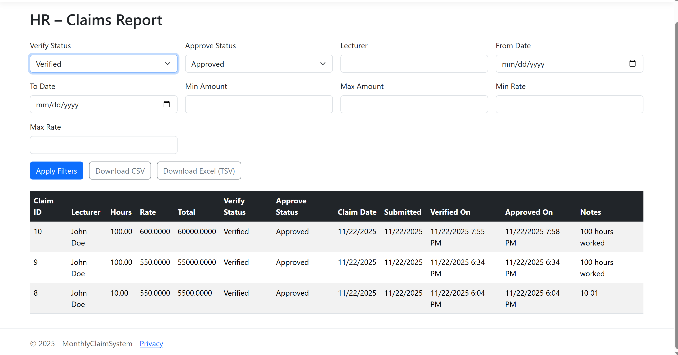

Slide 22
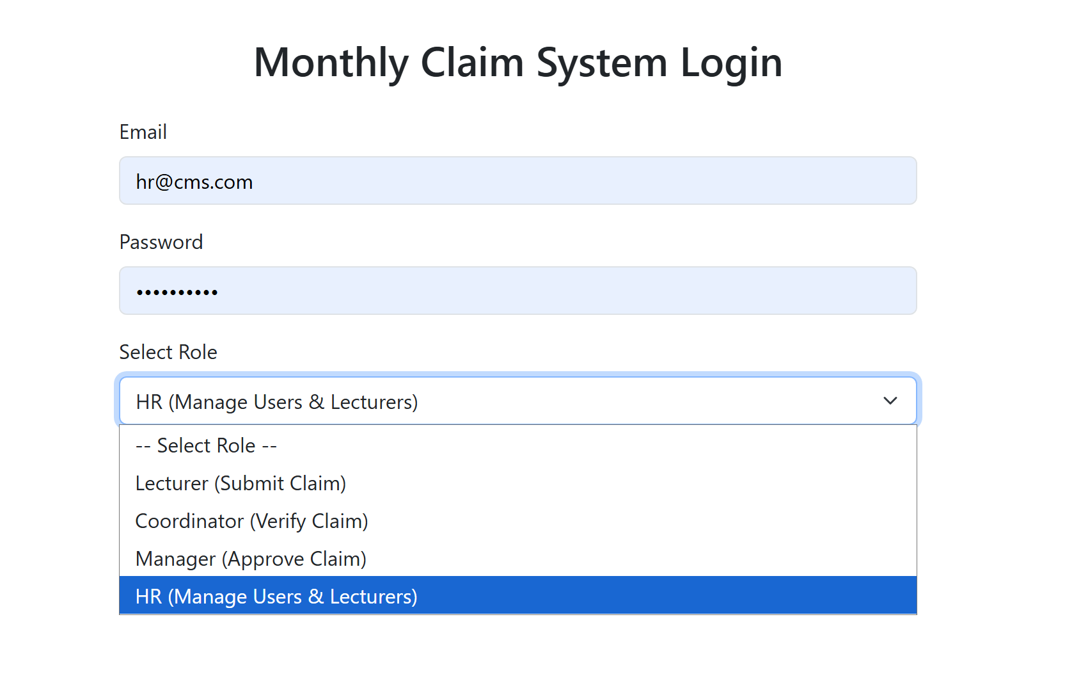

Slide 23
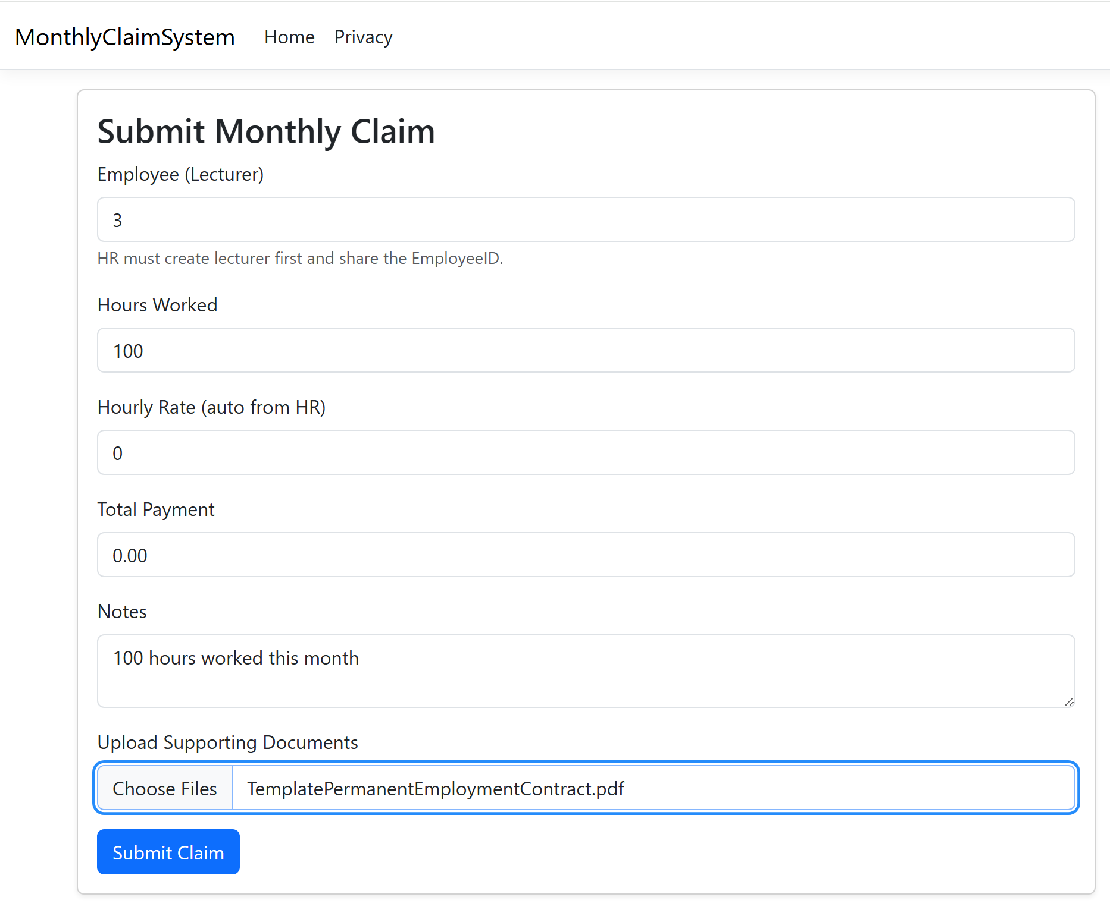

Slide 24
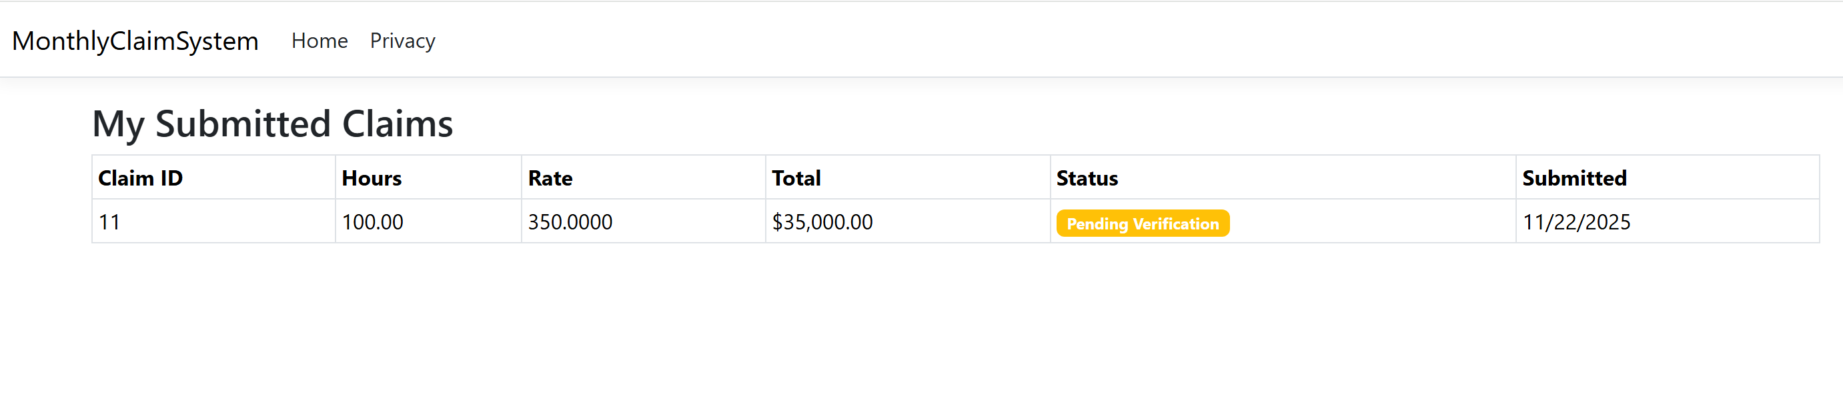

Slide 25
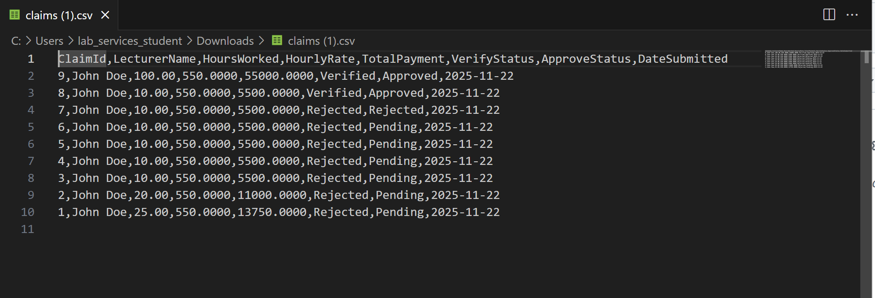

Slide 26
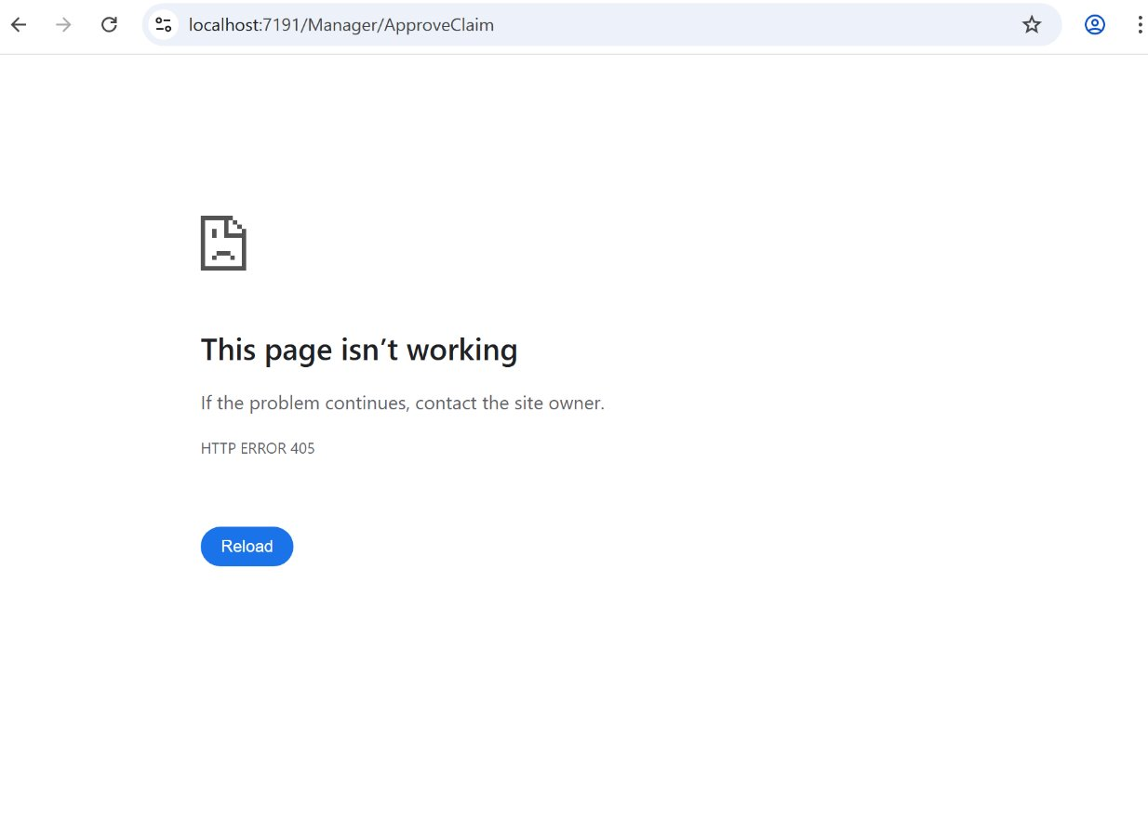
Cannot redirect to another page if logged in as another user

Slide 27
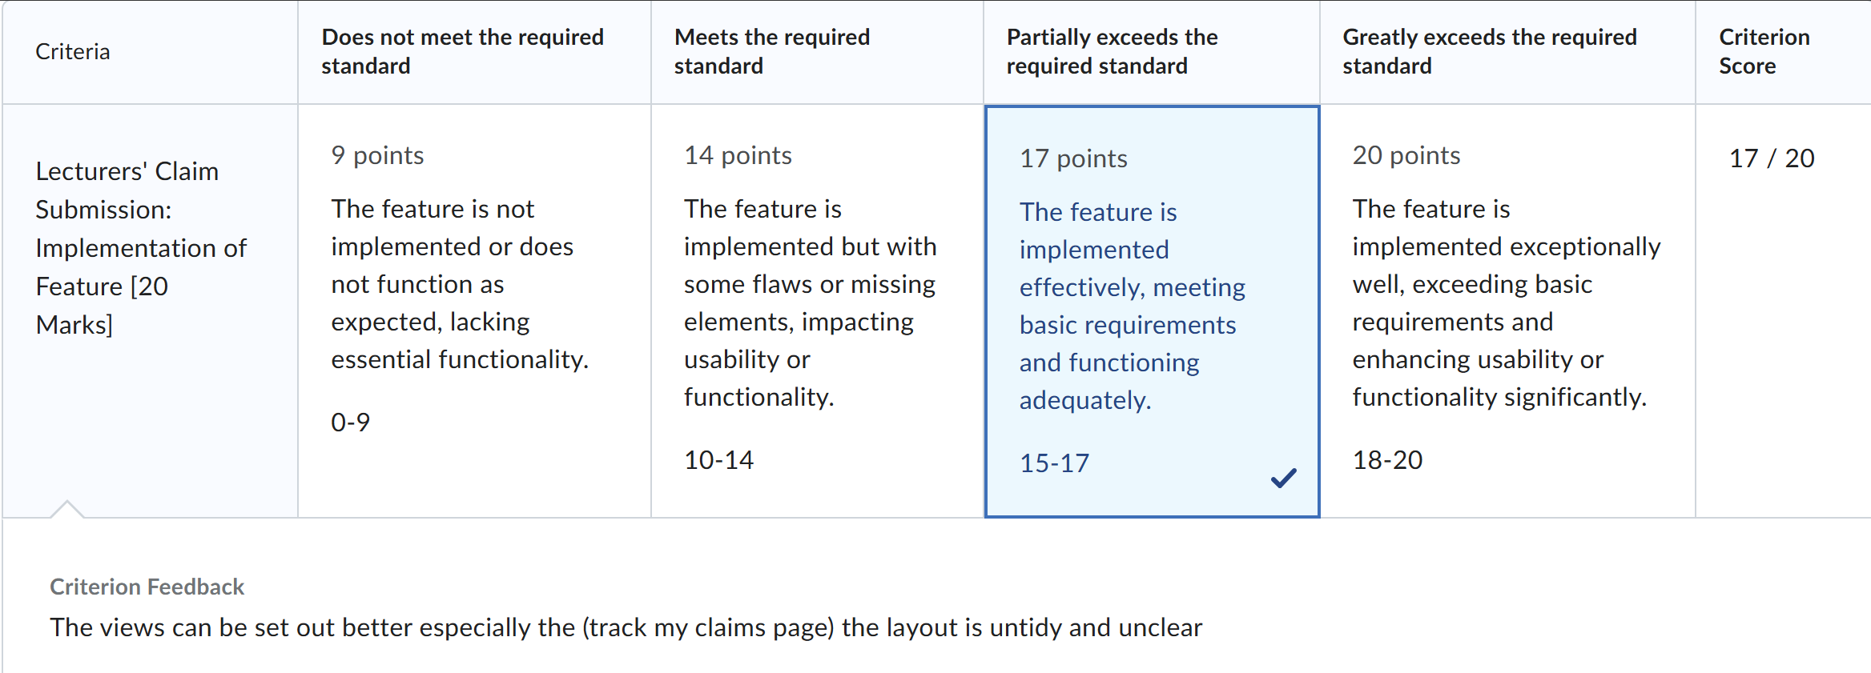
Feedback

Slide 28
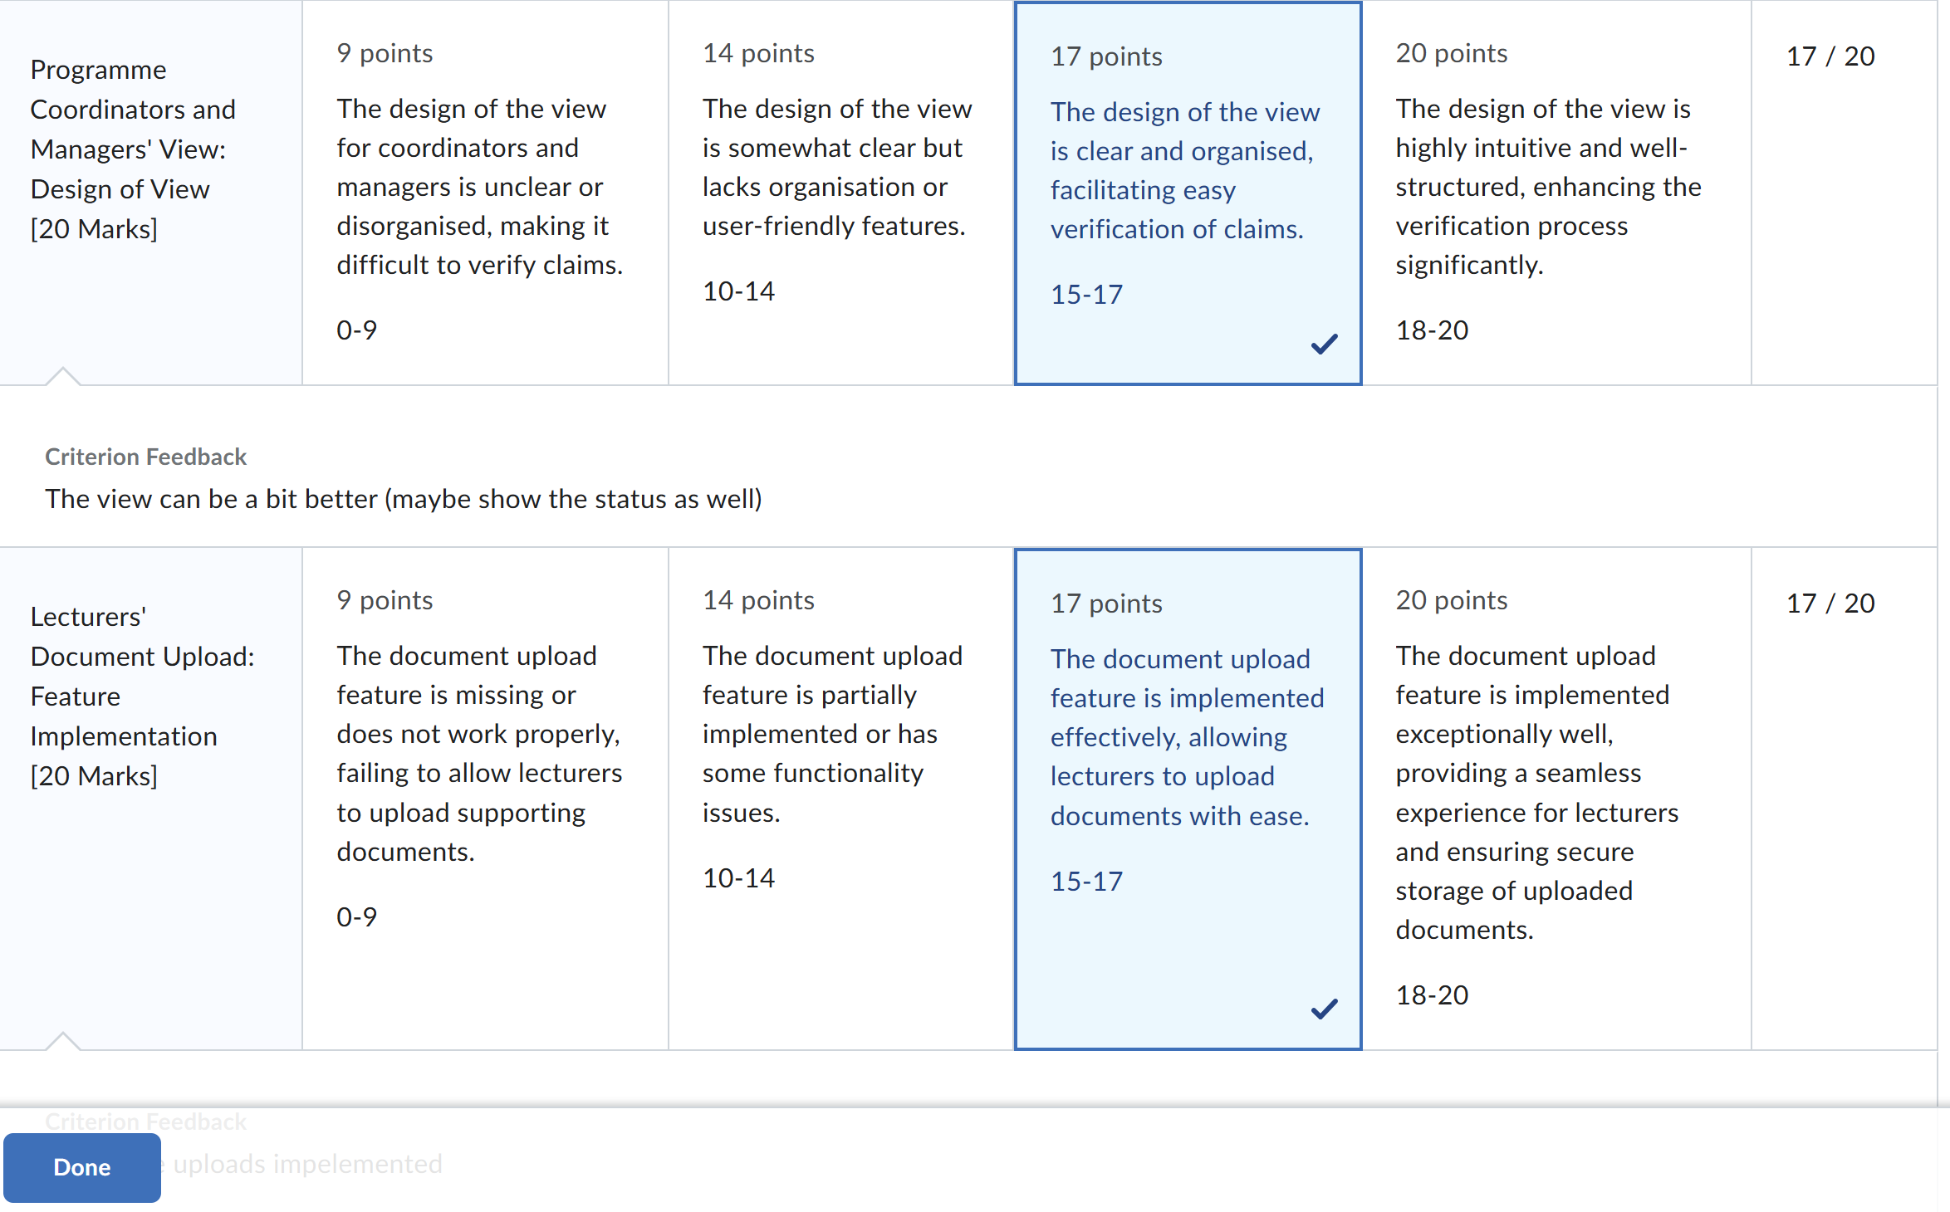

Slide 29
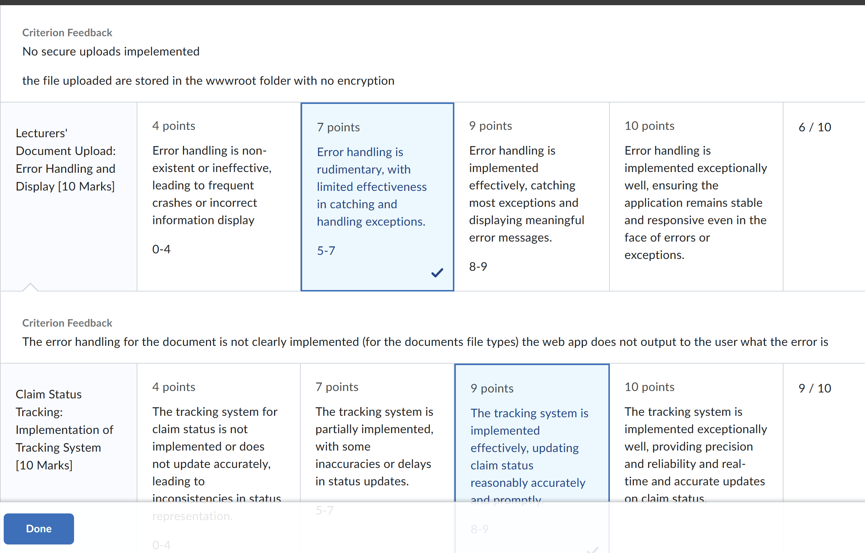

Slide 30
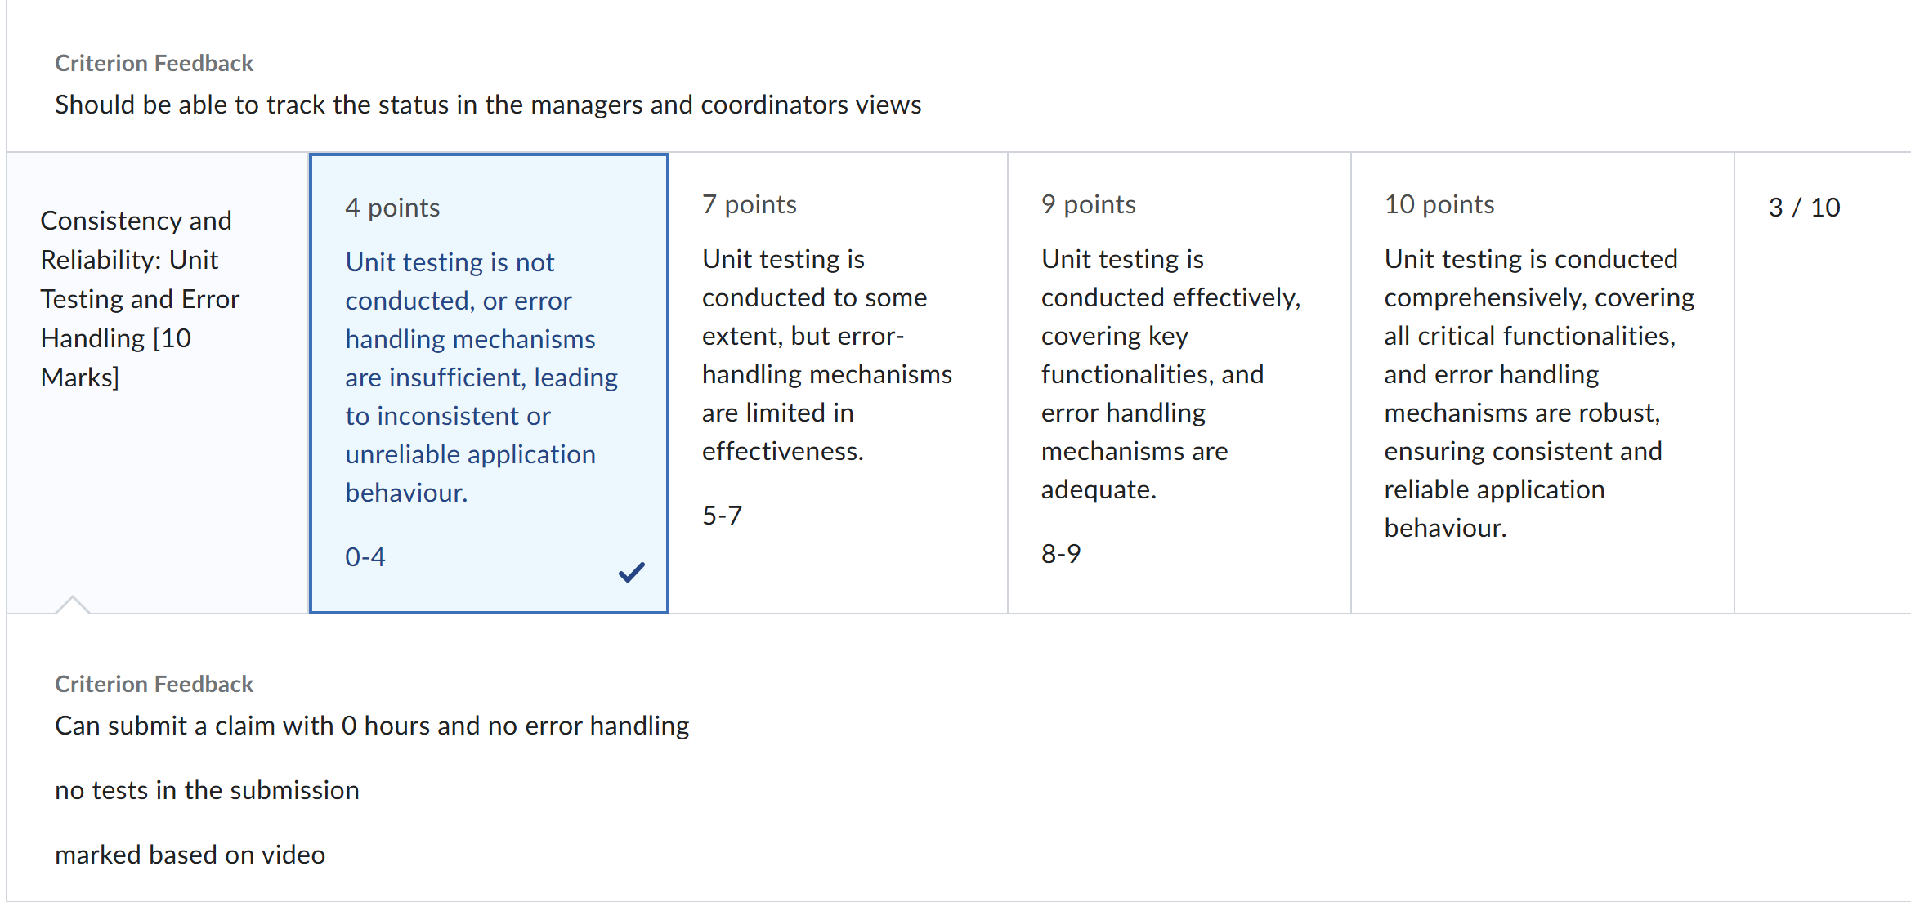

Slide 31
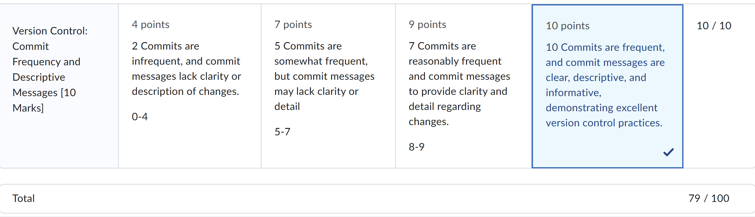

Slide 32
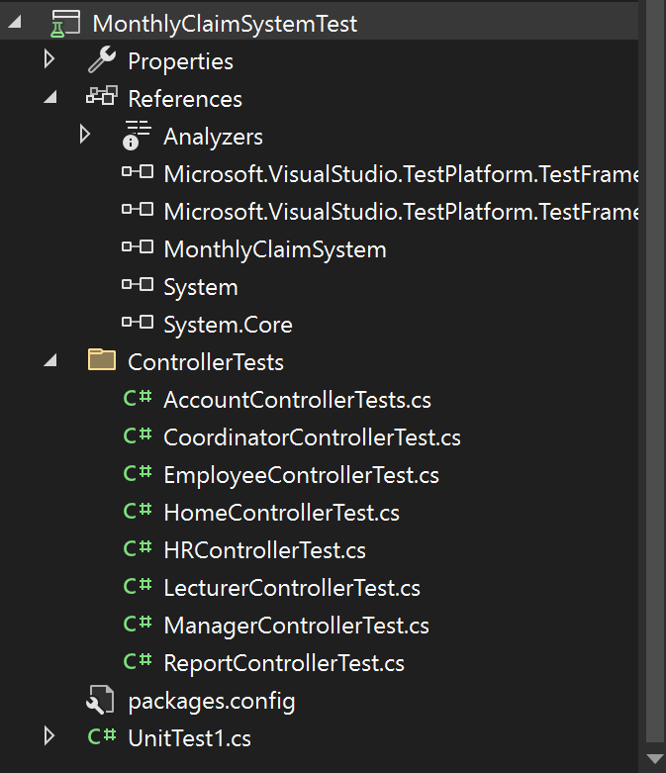
Unit Tests

Slide 33
Reference list
Code Maze, 2022. Unit Testing with xUnit in ASP.NET Core. [online] Available at: <https://code-maze.com/aspnetcore-unit-testing-xunit/> [Accessed 20 November 2025].
Microsoft Learn, n.d. Unit testing C# code in .NET using dotnet test and xUnit. [online] Available at: <https://learn.microsoft.com/en-us/dotnet/core/testing/unit-testing-csharp-with-xunit> [Accessed 20 November 2025].
Microsoft Learn, n.d. Scaffold Identity in ASP.NET Core projects. [online] Available at: <https://learn.microsoft.com/en-us/aspnet/core/security/authentication/scaffold-identity?view=aspnetcore-9.0> [Accessed 20 November 2025].
Microsoft Learn, n.d. Model validation in ASP.NET Core MVC. [online] Available at: <https://learn.microsoft.com/en-us/aspnet/core/mvc/models/validation?view=aspnetcore-9.0> [Accessed 20 November 2025].
Code Maze, 2024. How to Use ModelState Validation in ASP.NET Core Web API. [online] Available at: <https://code-maze.com/aspnetcore-modelstate-validation-web-api/> [Accessed 20 November 2025].
Microsoft Learn, n.d. Role-based authorization in ASP.NET Core. [online] Available at: <https://learn.microsoft.com/en-us/aspnet/core/security/authorization/roles?view=aspnetcore-8.0> [Accessed 20 November 2025].
Dot Net Tutorials, 2025. Role Based Authorization in ASP.NET Core Identity. [online] Available at: <https://dotnettutorials.net/lesson/role-based-authorization-asp-net-core-identity/> [Accessed 20 November 2025].

Slide 34
Microsoft Learn, n.d. Session and state management in ASP.NET Core. [online] Available at: <https://learn.microsoft.com/en-us/aspnet/core/fundamentals/app-state?view=aspnetcore-9.0>[Accessed 20 November 2025].
Dot Net Tutorials, 2025. Differences Between Cookies and Sessions in ASP.NET Core MVC. [online] Available at: <https://dotnettutorials.net/lesson/differences-between-cookies-and-sessions-in-asp-net-core-mvc/> [Accessed 20 November 2025].
Microsoft Learn, n.d. Hash passwords in ASP.NET Core. [online] Available at: <https://learn.microsoft.com/en-us/aspnet/core/security/data-protection/consumer-apis/password-hashing?view=aspnetcore-9.0> [Accessed 20 November 2025].
Code Maze, 2024. How the Default ASP.NET Core Identity Password Hasher Works. [online] Available at: <https://code-maze.com/aspnetcore-default-asp-net-core-identity-password-hasher/>[Accessed 20 November 2025].
Microsoft Tech Community, 2024. Encrypting and Decrypting Sensitive Information in ASP.NET Core. [online] Available at: <https://techcommunity.microsoft.com/blog/iis-support-blog/encrypting-and-decrypting-sensitive-information-in-asp-net-core/4252172> [Accessed 20 November 2025].
Microsoft Learn, n.d. ASP.NET Core Data Protection Overview. [online] Available at: <https://learn.microsoft.com/en-us/aspnet/core/security/data-protection/introduction?view=aspnetcore-9.0>[Accessed 20 November 2025].

Slide 35
